Slide 1

IT 334 – DevOps Engineering on AWS Cloud
Project – Building a Highly Available, Scalable Web Application
Group 6: Amila Čaušević Lejla Breščić Amna Ganić
Date:
11.6.2023.
Teacher: Dženana Dževlan

Slide 2
Business scenario overview
Scenario overview:
Subject: university web application
Problem: slow app or not available at all during the peak admissions period
Cause: high number of inquiries

Slide 3
Business scenario overview
Solution requirements:
Functional: The solution meets the functional requirements, such as the ability to view, add, delete, or modify the student records, without any perceivable delay.
Load balanced: The solution can properly balance user traffic to avoid overloaded or underutilized resources.
Scalable: The solution is designed to scale to meet the demands that are placed on the application.
Highly available: The solution is designed to have limited downtime when a web server becomes unavailable.
Secure: The database is secured and can’t be accessed directly from public networks.
The web servers and database can be accessed only over the appropriate ports.
The web application is accessible over the internet.
The database credentials aren’t hardcoded into the web application.
Cost optimized: The solution is designed to keep costs low.
High performing: The routine operations (viewing, adding, deleting, or modifying records) are performed without a perceivable delay under normal, variable, and peak loads.

Slide 4
Solution overview
We built:
highly available and scalable solution for hosting the student records web application
using best practices from the AWS Well-Architected Framework
utilization of load balancing, auto-scaling, and a multi-tier architecture to handle thousands of users during peak admissions while ensuring high performance and availability
Notes:
Explain at a high level what you have built.
For example: “I built a web application for a company to host their blog.“
Talk about why you chose certain parts of the solutions and any tradeoffs that you made. Focus on how you designed the solutions and how you applied the AWS Well-Architected Framework as part of the process (AWS Well-Architected Framework: https://docs.aws.amazon.com/wellarchitected/latest/framework/welcome.html).
For example: “I configured load balancers and auto scaling to make the application highly available and reliable.”
Include the use cases that you are addressing. Think about who your users are and how they would want to interact with your solution to solve their problem.
For example: “Users can view, upload, edit, and delete blog posts. Administrators can approve blog posts.”
Talk about the use cases that you addressed as part of the minimum viable product (MVP) that you scoped and built.
Note:
An above-bar description is concise and includes the most important benefits. For example: “The solution allows customers to quickly upload, store, and search large catalogs of images and videos in Amazon S3.”
A below-bar description is too detailed or not specific. For example: “Our solution analyzes media files.”

Slide 5
Solution overview
Design considerations:
multiple Availability Zones -> High availability
utilizing cost-effective AWS services - > Cost optimization
Amazon EC2 -> Functionality
Amazon RDS and EC2 Auto Scaling -> Scalability
Amazon VPC, Security group, Secrets Manager -> Security
Amazon ELB -> Load Balancing
Cloud 9 -> used to migrate database from instance to Amazon RDS
Notes:
Explain at a high level what you have built.
For example: “I built a web application for a company to host their blog.“
Talk about why you chose certain parts of the solutions and any tradeoffs that you made. Focus on how you designed the solutions and how you applied the AWS Well-Architected Framework as part of the process (AWS Well-Architected Framework: https://docs.aws.amazon.com/wellarchitected/latest/framework/welcome.html).
For example: “I configured load balancers and auto scaling to make the application highly available and reliable.”
Include the use cases that you are addressing. Think about who your users are and how they would want to interact with your solution to solve their problem.
For example: “Users can view, upload, edit, and delete blog posts. Administrators can approve blog posts.”
Talk about the use cases that you addressed as part of the minimum viable product (MVP) that you scoped and built.
Note:
An above-bar description is concise and includes the most important benefits. For example: “The solution allows customers to quickly upload, store, and search large catalogs of images and videos in Amazon S3.”
A below-bar description is too detailed or not specific. For example: “Our solution analyzes media files.”

Slide 6
Solution overview
Use case - Peak Admissions Period :
The solution is ideal for handling the high influx of users during the peak admissions period. By implementing auto-scaling and load balancing, the architecture can dynamically scale resources based on demand, ensuring that the web application remains responsive and available even during periods of heavy traffic. Users can view records while administrators can upload, edit, and delete posts.
Notes:
Explain at a high level what you have built.
For example: “I built a web application for a company to host their blog.“
Talk about why you chose certain parts of the solutions and any tradeoffs that you made. Focus on how you designed the solutions and how you applied the AWS Well-Architected Framework as part of the process (AWS Well-Architected Framework: https://docs.aws.amazon.com/wellarchitected/latest/framework/welcome.html).
For example: “I configured load balancers and auto scaling to make the application highly available and reliable.”
Include the use cases that you are addressing. Think about who your users are and how they would want to interact with your solution to solve their problem.
For example: “Users can view, upload, edit, and delete blog posts. Administrators can approve blog posts.”
Talk about the use cases that you addressed as part of the minimum viable product (MVP) that you scoped and built.
Note:
An above-bar description is concise and includes the most important benefits. For example: “The solution allows customers to quickly upload, store, and search large catalogs of images and videos in Amazon S3.”
A below-bar description is too detailed or not specific. For example: “Our solution analyzes media files.”

Slide 7
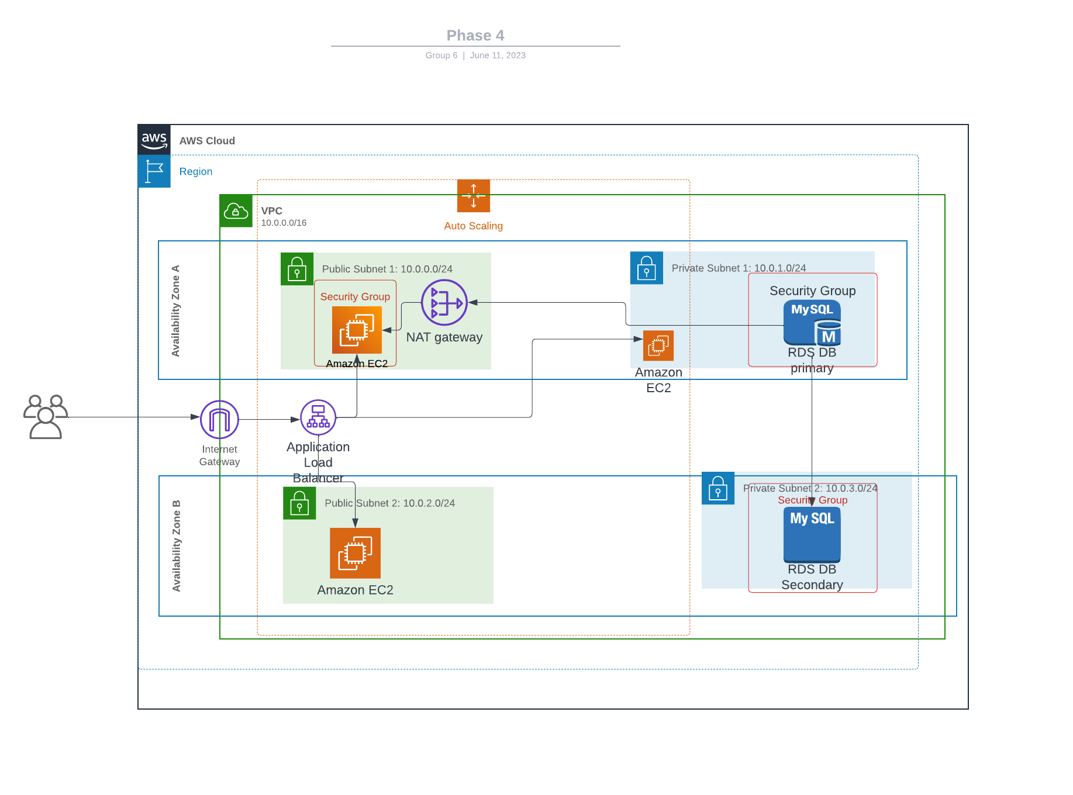
Architecture diagram of the solution
Diagram generated with Lucidchart
Notes:
Note: Remove this slide from your final presentation.
This example architecture diagram shows a solution to configure a webhook to link Git with AWS. You can find this example in the Toolkits for PowerPoint at https://aws.amazon.com/architecture/icons.

Slide 8
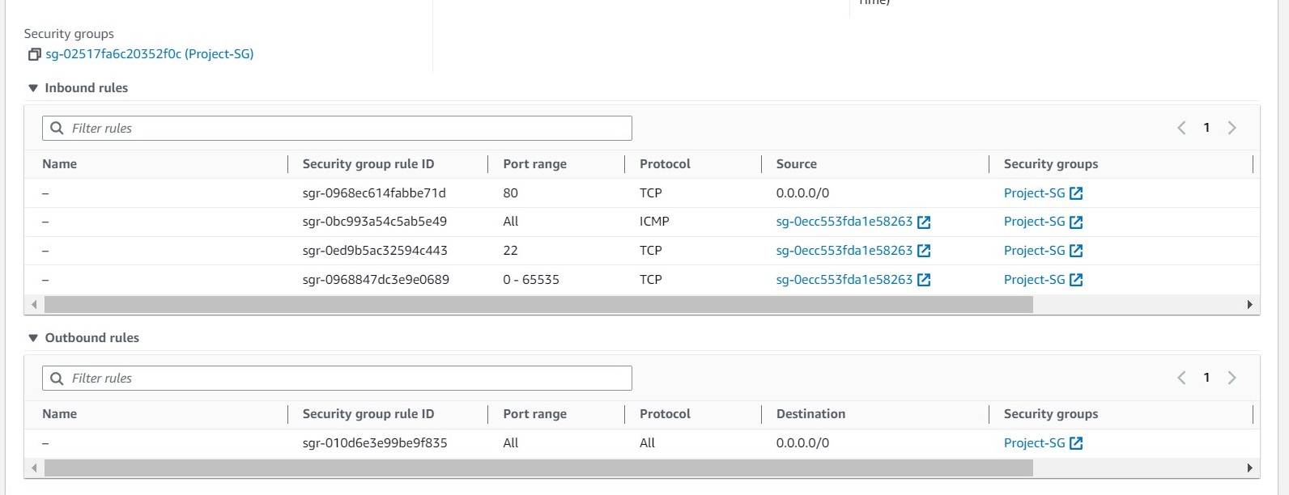
Demo
Notes:
For the demo, guide the audience through the two to three most important benefits of the solution and how it addresses the requirements.
Your demo materials can be screen captures, recordings, or to show AWS console.

Slide 9
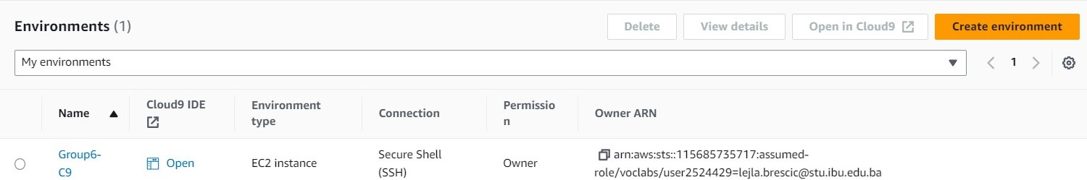
Demo
Notes:
For the demo, guide the audience through the two to three most important benefits of the solution and how it addresses the requirements.
Your demo materials can be screen captures, recordings, or to show AWS console.

Slide 10
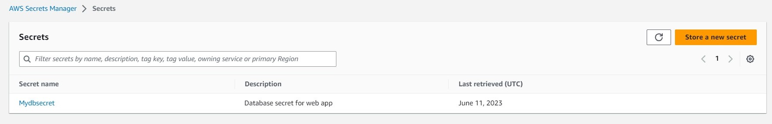
Demo
Notes:
For the demo, guide the audience through the two to three most important benefits of the solution and how it addresses the requirements.
Your demo materials can be screen captures, recordings, or to show AWS console.

Slide 11
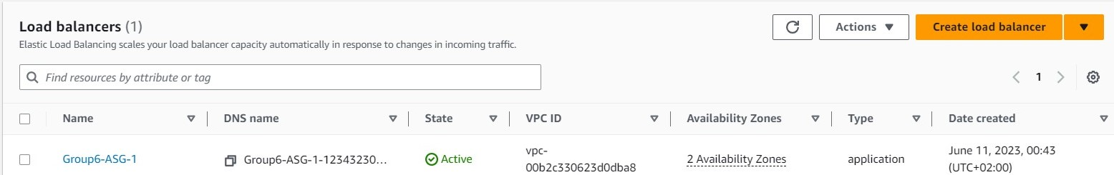
Demo
Notes:
For the demo, guide the audience through the two to three most important benefits of the solution and how it addresses the requirements.
Your demo materials can be screen captures, recordings, or to show AWS console.

Slide 12
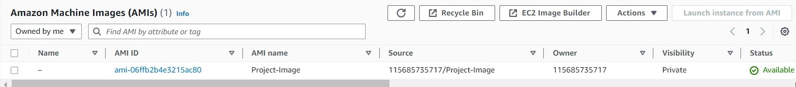
Demo
Notes:
For the demo, guide the audience through the two to three most important benefits of the solution and how it addresses the requirements.
Your demo materials can be screen captures, recordings, or to show AWS console.

Slide 13
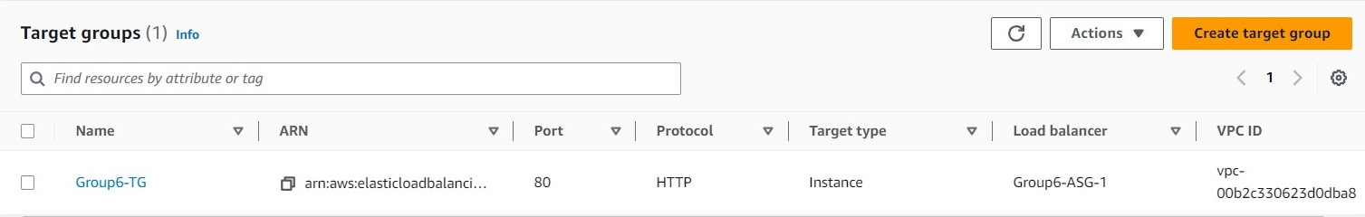
Demo
Notes:
For the demo, guide the audience through the two to three most important benefits of the solution and how it addresses the requirements.
Your demo materials can be screen captures, recordings, or to show AWS console.

Slide 14
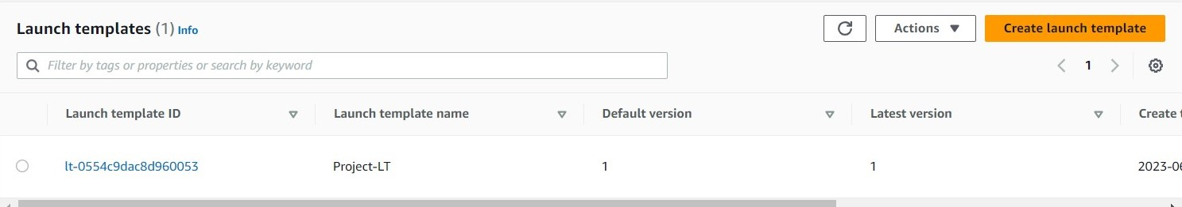
Demo
Notes:
For the demo, guide the audience through the two to three most important benefits of the solution and how it addresses the requirements.
Your demo materials can be screen captures, recordings, or to show AWS console.

Slide 15
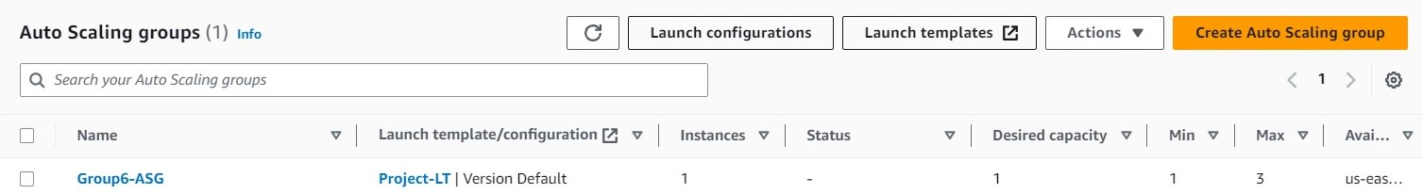
Demo
Notes:
For the demo, guide the audience through the two to three most important benefits of the solution and how it addresses the requirements.
Your demo materials can be screen captures, recordings, or to show AWS console.

Slide 16
Lessons learned
Challenges Regarding the problems, we have encountered a few of them. - First, when creating EC2 instances & VPC and its services manually, our EC2 instance couldn’t connect to the public IPv4 address. Then we decided to follow the module on AWS Academy, we automatically created VPC, IGW, NAT Gateway, public and private subnets and appropriate security group, the EC2 instance has connected successfully. - When in the C9 console, we couldn’t migrate the data from EC2 to Amazon RDS, because we didn’t open required ports for the instance. After adding the appropriate inbound rules, the C9 console commands started working and the migration could start. The second issue was that we had to firstly create the database and then to migrate the information.
Notes:
Describe any challenges that you encountered and how you overcame those challenges.
For example: “I got stuck when I was creating an EC2 instance to host the application. I used the resources that were listed in the instructions to walk myself through the process to create a new EC2, and I was able to complete the task. The links to labs in other courses were very helpful.”
Describe any new skills that you learned from this project.
For example: “I learned how to set up auto scaling correctly so my resources were automatically adjusted and allocated at the lowest possible cost.”
Discuss any future, out-of-scope use cases in the next steps.
For example: “I would like to scale out the web application so that multiple departments can use it.”

Slide 17
For the load balancer, sometimes its DNS value is not working for some reason.
Resources
https://awsacademy.instructure.com/courses/49302/modules/items/4245907
https://docs.aws.amazon.com/pricing-calculator/index.html
https://docs.aws.amazon.com/elasticloadbalancing/latest/application/application-load-balancers.html
https://awsacademy.instructure.com/courses/49302/modules/items/4246031
https://www.youtube.com/watch?v=aeLdPYGnn_Q
https://awsacademy.instructure.com/courses/49302/modules/items/4246271
https://awsacademy.instructure.com/courses/49302/modules/items/4246188

Slide 18
Lessons learned
New skills
We learned how to divide the project into two separate infrastructures : web server & database.
We learned to enable the auto-scaling and to see how the new instance is being created as a backup, while the other one is terminated.
Next steps
We would like to explore new ways on how to fullfil all the requirements and to deploy the application.
We would also like to learn on how to minimize the costs as much as possible and to estimate the costs more precise to build the better infrastructure.

Slide 19

Questions?

Slide 20
Thank you for your attention.

